Slide 1


고객가치
새로운 시도
집요한 실행
XY Cal methods 비교 분석

Slide 2
History
1987
1998
2005
Two–step method by Tsai.
Robust and easy-to-adopt method by Zhang.
Diffractive Optical Elements (DOE) Calibration by Kruger (Tesseract).
 | Tsai (1987) | Zhang (1998) | Kruger (2005)
Character | Combine linear and non-linear modeling to improve accuracy. | Linear lens modeling and non-linear optimization of lens parameters. | Diffractive optical elements
Pros | Less dependent convergence on the initial value. | Robust and accurate. Easy–to-understand principle. Need no expensive equipment. | No requirement for large space. Short operation time.
Cons | Low speed. Requirement for elaborate equipment. | Low speed. Strongly affected by target position. | Expensive and elaborate equipment. Pre-acquired coordinates of the DOE spots. Restricted FOV due to the coverage of the DOE.

Slide 3
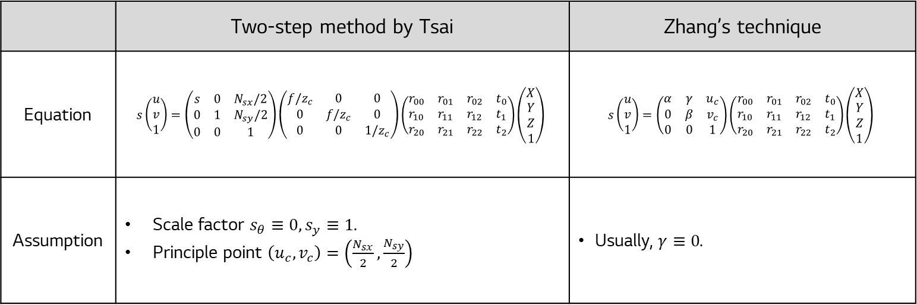
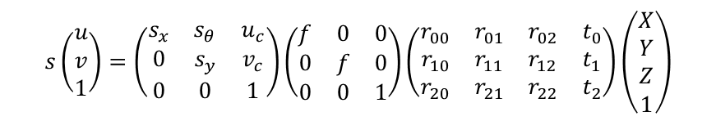
Tsai vs Zhang
Assumption
Pinhole camera model
$$s\left(\begin{aligned}u \\ v \\ 1\end{aligned}\right)=\left(\begin{matrix}s_{x} & s_{θ} & u_{c} \\ 0 & s_{y} & v_{c} \\ 0 & 0 & 1\end{matrix}\right)\left(\begin{matrix}f & 0 & 0 \\ 0 & f & 0 \\ 0 & 0 & 1\end{matrix}\right)\left(\begin{matrix}r_{00} & r_{01} & r_{02} & t_{0} \\ r_{10} & r_{11} & r_{12} & t_{1} \\ r_{20} & r_{21} & r_{22} & t_{2}\end{matrix}\right)\left(\begin{aligned}X \\ Y \\ Z \\ 1\end{aligned}\right)$$
 | Two-step method by Tsai | Zhang’s technique
Equation | $$s\left(\begin{aligned}u \\ v \\ 1\end{aligned}\right)=\left(\begin{matrix}s & 0 & N_{sx}/2 \\ 0 & 1 & N_{sy}/2 \\ 0 & 0 & 1\end{matrix}\right)\left(\begin{matrix}f/z_{c} & 0 & 0 \\ 0 & f/z_{c} & 0 \\ 0 & 0 & 1/z_{c}\end{matrix}\right)\left(\begin{matrix}r_{00} & r_{01} & r_{02} & t_{0} \\ r_{10} & r_{11} & r_{12} & t_{1} \\ r_{20} & r_{21} & r_{22} & t_{2}\end{matrix}\right)\left(\begin{aligned}X \\ Y \\ Z \\ 1\end{aligned}\right)$$ | $$s\left(\begin{aligned}u \\ v \\ 1\end{aligned}\right)=\left(\begin{matrix}α & γ & u_{c} \\ 0 & β & v_{c} \\ 0 & 0 & 1\end{matrix}\right)\left(\begin{matrix}r_{00} & r_{01} & r_{02} & t_{0} \\ r_{10} & r_{11} & r_{12} & t_{1} \\ r_{20} & r_{21} & r_{22} & t_{2}\end{matrix}\right)\left(\begin{aligned}X \\ Y \\ Z \\ 1\end{aligned}\right)$$
Assumption | Scale factor $s_{θ}≡0, s_{y}≡1$. Principle point $\left(u_{c},v_{c}\right)=\left(\frac{N_{sx}}{2},\frac{N_{sy}}{2}\right)$ | Usually, $γ≡0$.

Slide 4

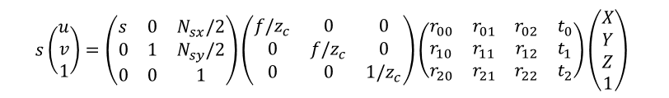


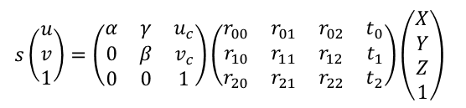



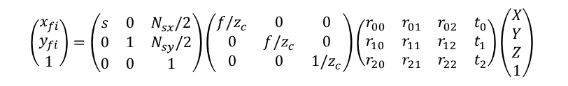
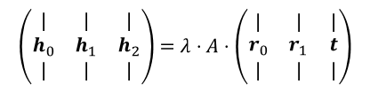


Tsai vs Zhang
 | Two-step method by Tsai | Zhang’s technique
Equation
Key math
$$s\left(\begin{aligned}u \\ v \\ 1\end{aligned}\right)=\left(\begin{matrix}s & 0 & N_{sx}/2 \\ 0 & 1 & N_{sy}/2 \\ 0 & 0 & 1\end{matrix}\right)\left(\begin{matrix}f/z_{c} & 0 & 0 \\ 0 & f/z_{c} & 0 \\ 0 & 0 & 1/z_{c}\end{matrix}\right)\left(\begin{matrix}r_{00} & r_{01} & r_{02} & t_{0} \\ r_{10} & r_{11} & r_{12} & t_{1} \\ r_{20} & r_{21} & r_{22} & t_{2}\end{matrix}\right)\left(\begin{aligned}X \\ Y \\ Z \\ 1\end{aligned}\right)$$
$$s\left(\begin{aligned}u \\ v \\ 1\end{aligned}\right)=\left(\begin{matrix}α & γ & u_{c} \\ 0 & β & v_{c} \\ 0 & 0 & 1\end{matrix}\right)\left(\begin{matrix}r_{00} & r_{01} & r_{02} & t_{0} \\ r_{10} & r_{11} & r_{12} & t_{1} \\ r_{20} & r_{21} & r_{22} & t_{2}\end{matrix}\right)\left(\begin{aligned}X \\ Y \\ Z \\ 1\end{aligned}\right)$$
$$\left(\begin{aligned}x_{fi} \\ y_{fi} \\ 1\end{aligned}\right)=\left(\begin{matrix}s & 0 & N_{sx}/2 \\ 0 & 1 & N_{sy}/2 \\ 0 & 0 & 1\end{matrix}\right)\left(\begin{matrix}f/z_{c} & 0 & 0 \\ 0 & f/z_{c} & 0 \\ 0 & 0 & 1/z_{c}\end{matrix}\right)\left(\begin{matrix}r_{00} & r_{01} & r_{02} & t_{0} \\ r_{10} & r_{11} & r_{12} & t_{1} \\ r_{20} & r_{21} & r_{22} & t_{2}\end{matrix}\right)\left(\begin{aligned}X \\ Y \\ Z \\ 1\end{aligned}\right)$$
Let $Z=0$
$$\left(\begin{matrix}| & | & | \\ h_{0} & h_{1} & h_{2} \\ | & | & |\end{matrix}\right)=λ⋅A⋅\left(\begin{matrix}| & | & | \\ r_{0} & r_{1} & t \\ | & | & |\end{matrix}\right)$$
Derive the relation such that
$$\overline{x}≡x_{fi}−\frac{N_{sx}}{2}=sx_{i} \\ \overline{y}≡y_{fi}−\frac{N_{sy}}{2}=y_{i}$$
Since the rotation matrix is unitary,
$$r_{0}^{T}r_{1}=r_{1}^{T}r_{0}=0$$
$$r_{0}^{T}r_{0}=r_{1}^{T}r_{1}=1$$
$$\left[\begin{matrix}\overline{y}x_{w} & \overline{y}y_{w} & \overline{y}z_{w} & \overline{y} & −\overline{x}x_{w} & −\overline{x}y_{w} & −\overline{x}z_{w}\end{matrix}\right]\left[\begin{aligned}b_{1} \\ b_{2} \\ b_{3} \\ b_{4} \\ b_{5} \\ b_{6} \\ b_{7}\end{aligned}\right]=\overline{x}$$
For $n≥7$ points, calculate
Substituting $r_{0}$ and $r_{1}$,
$$h_{0}=λAr_{0} \\ h_{1}=λAr_{1}$$
For each view, we obtain two equations.
$$\left[\begin{matrix}\left(r_{4}x_{w}+r_{5}y_{w}+r_{6}z_{w}+t_{y}\right) & −\overline{y}\end{matrix}\right]\left[\begin{aligned}f \\ t_{z}\end{aligned}\right]=\left(r_{7}x_{w}+r_{8}y_{w}+r_{9}z_{w}\right)\overline{y}$$
$$h_{0}^{T}⋅{\left(A^{−1}\right)}^{T}A^{−1}h_{1}=0 \\ h_{0}^{T}⋅{\left(A^{−1}\right)}^{T}A^{−1}h_{0}=h_{1}^{T}⋅{\left(A^{−1}\right)}^{T}A^{−1}h_{1}$$

Slide 5
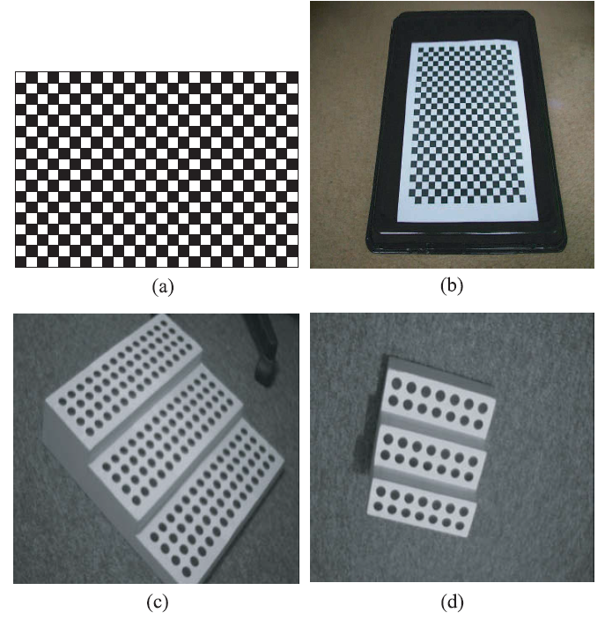
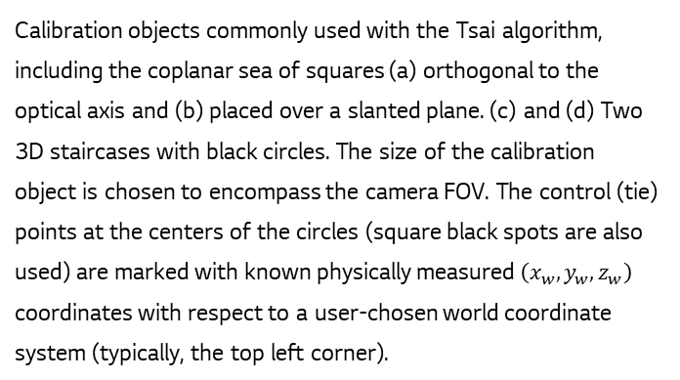
Tsai vs Zhang
Calibration objects commonly used with the Tsai algorithm, including the coplanar sea of squares (a) orthogonal to the optical axis and (b) placed over a slanted plane. (c) and (d) Two 3D staircases with black circles. The size of the calibration object is chosen to encompass the camera FOV. The control (tie) points at the centers of the circles (square black spots are also used) are marked with known physically measured $\left(x_{w},y_{w},z_{w}\right)$ coordinates with respect to a user-chosen world coordinate system (typically, the top left corner).
Tsai의 방식이나 Zhang의 방식이나 수식이 같으므로 target 의 형태도 같다.
 | Tsai | Zhang
정확도 | 높음 | 높음
실험 시간 | 오래 걸림 | 오래 걸림
수식의 복잡성 | 복잡 | 간단
장비 수준 | 정교해야 됨 | 덜 정교해도 됨
장비 가격 | 비싼 편 | 덜 비쌈

Slide 6
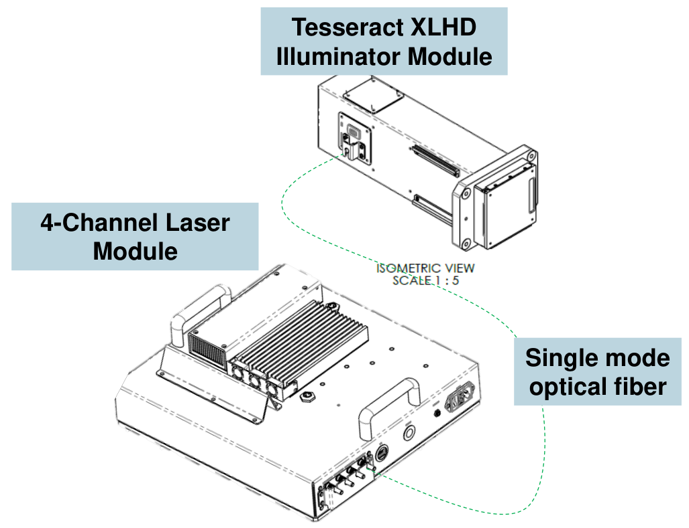
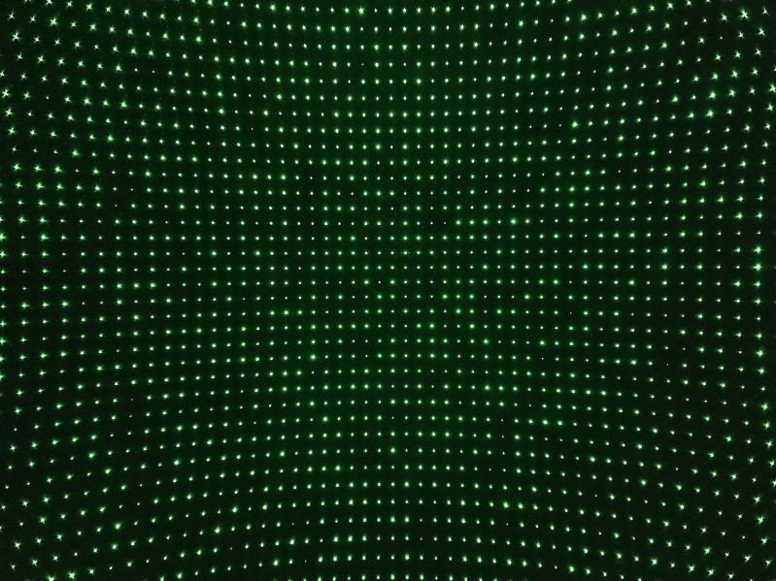
DOE Calibration
Diffractive Optical Element
Tesseract 의 방식
Quartus Inc.의 Tesseract는 이번 Eagle/Falcon에서 채택된 Lens Calibration 장비
출처: 전필준 선임 tesseract 분석 자료

Slide 7
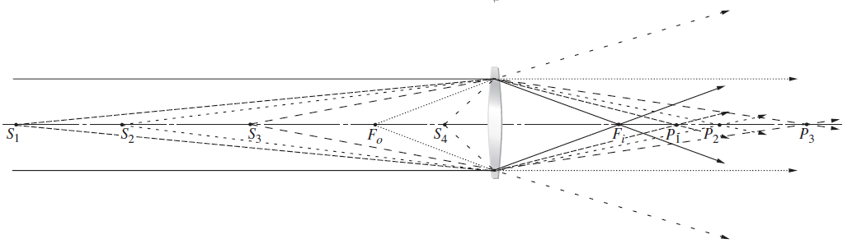
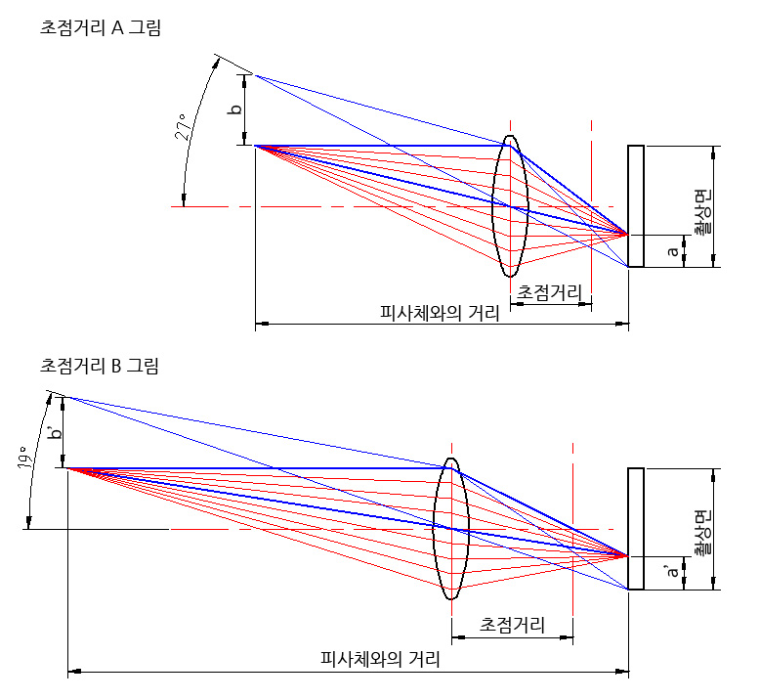

DOE Calibration: Motivation
Parallel light (Source is at infinity)
$$a^{′}=a$$
$$b^{′}=b$$
When the target is at infinity, the image is focused on the focal point.
If the target is at a close distance, the image is focused on the point behind the focal point.
When the focal length of the lens gets longer, the target should be located farther.

Slide 8
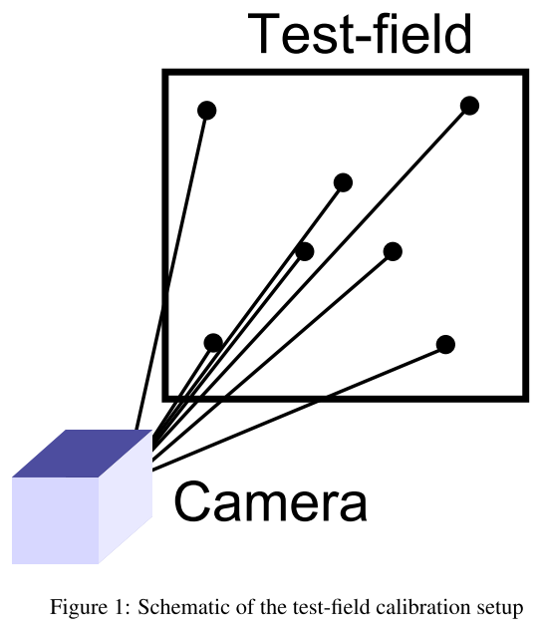
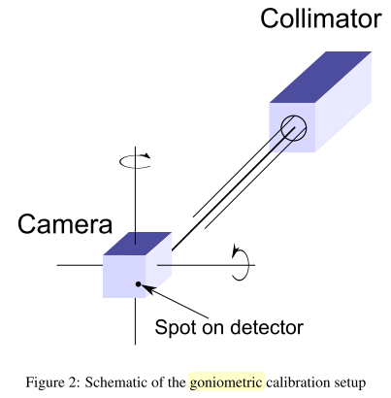
DOE Calibration: Motivation
Zhang’s technique / Tsai’s two-step method.
Test-field Calibration is valid regardless of the focal length.
However, when the focal length of a lens is long and the target is located at a close distance, the dots or corners on the test-field are hardly detected. Test-field must be located at a long distance.
Unfortunately, in laboratory circumstances, it is hard to secure a large space.
If a collimator is used, a parallel light can be generated which can be considered as light from infinity, at a short distance.
image from: https://knowltographer.blogspot.com/2021/07/focal-length-angle-viewing-angle.html

Slide 9




DOE Calibration: Motivation
Collimator
$$\left(0,0\right)$$
image plane
$$x$$
Camera
$$y$$
If we move back and forth toward the collimator, the $x,y$ coordinate of the image point is invariant under the translation.
We don’t have to move the camera. $→$ Only rotating it.

Slide 10









DOE Calibration: Motivation
$+θ°$ rotation along $y$ axis.
Top view
image plane
$$θ$$
$$\left(0,0\right)$$
$$\left(\tan{θ},0\right)$$
$$θ$$
$$\left(\sin{θ},0\right)$$
$$x$$
$$\left(\sin{θ},0\right)$$
$$y$$
One spot acquisition per rotation. Empirically, it requires approximately 100 spots.
However, rotating the camera or collimator takes a long time.

Slide 11

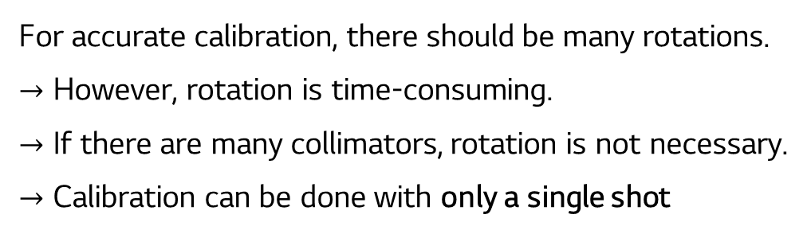

DOE Calibration: Motivation
image plane
$$x$$
$$y$$
For accurate calibration, there should be many rotations.
$→$ However, rotation is time-consuming.
$→$ If there are many collimators, rotation is not necessary.
$→$ Calibration can be done with only a single shot

Slide 12
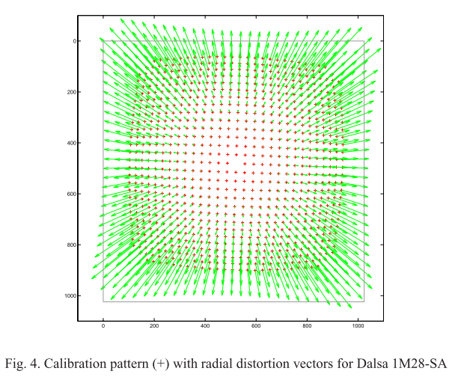


DOE Calibration: Motivation
image plane
ideal $\left(x,y\right)$
captured $\left(x,y\right)$
We can obtain the ideal $\left(x,y\right)$ coordinate of all beams.
By comparison to the captured image, we can calculate the radial distortion parameters.

Slide 13
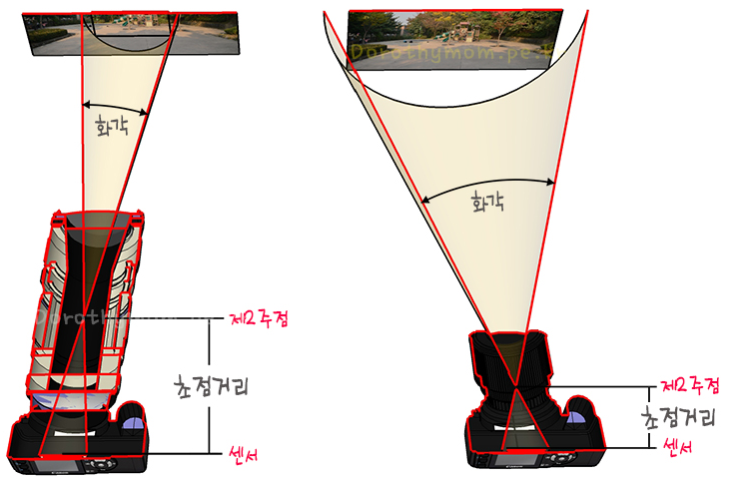
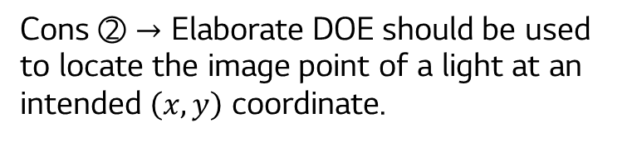
DOE Calibration: Cons
image plane
Cons ① DOE should be larger than FOV
Cons ② $→$ Elaborate DOE should be used to locate the image point of a light at an intended $\left(x,y\right)$ coordinate.
Cons ③ For a lens with a long focal length, FOV is small. Then, it has little radial distortion, which makes it difficult to determine the principal point.

Slide 14
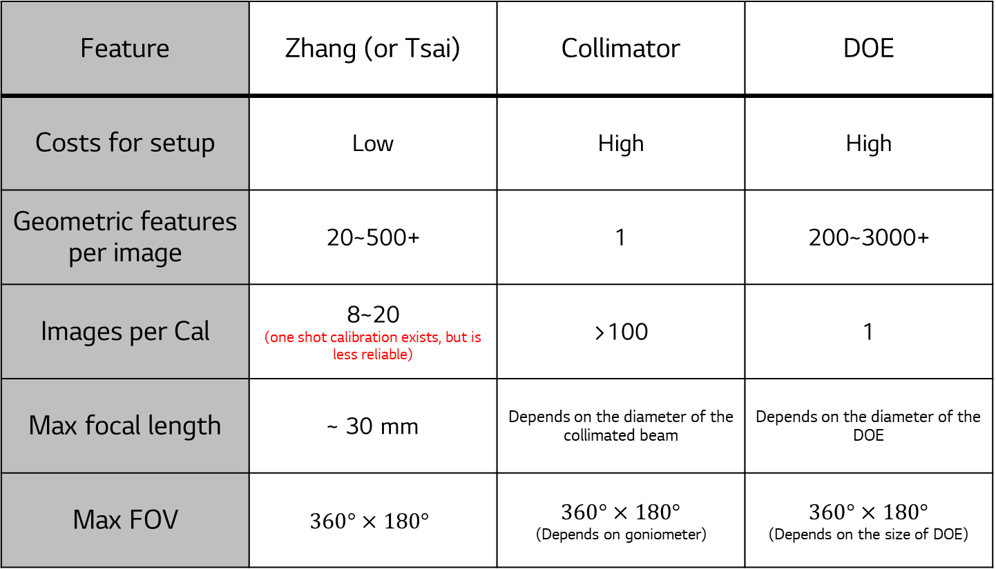
Zhang vs collimator vs DOE
Feature | Zhang (or Tsai) | Collimator | DOE
Costs for setup | Low | High | High
Geometric features per image | 20~500+ | 1 | 200~3000+
Images per Cal | 8~20 (one shot calibration exists, but is less reliable) | >100 | 1
Max focal length | ~ 30 mm | Depends on the diameter of the collimated beam | Depends on the diameter of the DOE
Max FOV | $$360°×180°$$ | $$360°×180°$$ (Depends on goniometer) | $$360°×180°$$ (Depends on the size of DOE)

Slide 15
Reference
Tsai, R. Y. (1987). A Versatile Camera Calibration Technique for High-Accuracy 3D Machine Vision Metrology Using Off-the-Shelf TV Cameras and Lenses. IEEE Journal on Robotics and Automation, 3(4), 323–344. https://doi.org/10.1109/JRA.1987.1087109
Sinha, P. K. (2012). Camera Calibration. In Image acquisition and preprocessing for machine vision systems (1st ed.). SPIE PRESS. https://doi.org/10.1111/j.1477-9730.1960.tb01300.x
Zhang, Z. (2000). A Flexible New Technique for Camera Calibration. IEEE Transactions on Pattern Analysis and Machine Intelligence, 22(11), 1330–1334.
Krüger, S., Scheele, M., & Schuster, R. (2005). New Calibration Scheme for Panoramic Line Scanners. International Archives of Photogrammetry, Remote Sensing and Spatial Information Sciences, XXXVI-5/W8, 1–4.
Bauer, M., Grießbach, D., Hermerschmidt, A., Krüger, S., Scheele, M., & Schischmanow, A. (2008). Geometrical camera calibration with diffractive optical elements. Optics Express, 16(25), 20241. https://doi.org/10.1364/oe.16.020241
Jan Hieronymus. (2012). COMPARISON OF METHODS FOR GEOMETRIC CAMERA CALIBRATION. International Archives of Photogrammetry, Remote Sensing and Spatial Information Sciences, XXXIX(September), 595–599.

Slide 16
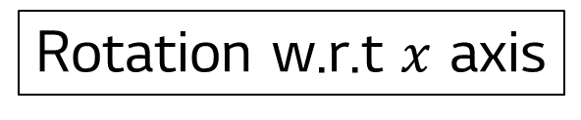





DOE Calibration: Motivation
Rotation w.r.t $x$ axis
However, rotating the camera or collimator takes a long time.
$$\left(\begin{matrix}1 & 0 & 0 \\ 0 & \cos{θ} & −\sin{θ} \\ 0 & \sin{θ} & \cos{θ}\end{matrix}\right)\left(\begin{matrix}0 \\ 0 \\ 1\end{matrix}\right)=\left(\begin{matrix}0 \\ −\sin{θ} \\ \cos{θ}\end{matrix}\right)$$
$$\left(\begin{matrix}\cos{θ} & 0 & \sin{θ} \\ 0 & 1 & 0 \\ −sin{θ} & 0 & \cos{θ}\end{matrix}\right)\left(\begin{matrix}0 \\ 0 \\ 1\end{matrix}\right)=\left(\begin{matrix}\sin{θ} \\ 0 \\ \cos{θ}\end{matrix}\right)$$
Collimator
Collimator
image plane
$$\left(0,0,1\right)$$
$$θ$$
$$\left(−\sin{θ},0,\cos{θ}\right)$$
image plane
Camera

Slide 17
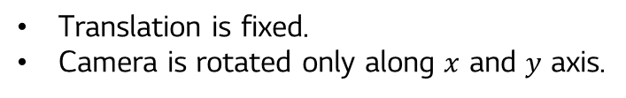
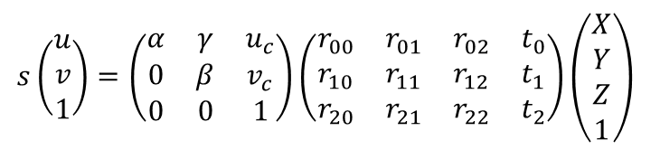
DOE Calibration: Motivation
When the focal length is increased,
The distance between lens and image plane increased.
FOV is reduced.
The projected size of an object at a far distance becomes the same as the object at a close distance. That is, the lens can see the object at a farther distance.
When the focal length of the lens is long, the target at a short distance is hardly identified.
To calibrate and undistort the lens with a long focal length, the target plane should be placed at a long distance.
$$s\left(\begin{aligned}u \\ v \\ 1\end{aligned}\right)=\left(\begin{matrix}α & γ & u_{c} \\ 0 & β & v_{c} \\ 0 & 0 & 1\end{matrix}\right)\left(\begin{matrix}r_{00} & r_{01} & r_{02} & t_{0} \\ r_{10} & r_{11} & r_{12} & t_{1} \\ r_{20} & r_{21} & r_{22} & t_{2}\end{matrix}\right)\left(\begin{aligned}X \\ Y \\ Z \\ 1\end{aligned}\right)$$
Translation is fixed.
Camera is rotated only along $x$ and $y$ axis.

Slide 18
DOE Calibration: Pros and Cons
image plane

Slide 19



이미지 출처: https://blog.naver.com/PostView.nhn?isHttpsRedirect=true&blogId=astalw&logNo=100169734052
Collimator
$−30°$ rotation
image plane
$$\left(0,0,1\right)$$
image plane
$$θ$$
Camera

Slide 20
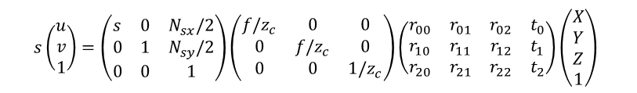
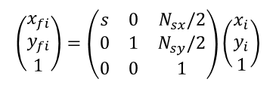

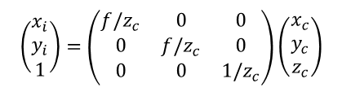

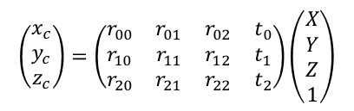

Tsai vs Zhang
 | Two-step method by Tsai | Zhang’s technique
Equation
Key math
$$s\left(\begin{aligned}u \\ v \\ 1\end{aligned}\right)=\left(\begin{matrix}s & 0 & N_{sx}/2 \\ 0 & 1 & N_{sy}/2 \\ 0 & 0 & 1\end{matrix}\right)\left(\begin{matrix}f/z_{c} & 0 & 0 \\ 0 & f/z_{c} & 0 \\ 0 & 0 & 1/z_{c}\end{matrix}\right)\left(\begin{matrix}r_{00} & r_{01} & r_{02} & t_{0} \\ r_{10} & r_{11} & r_{12} & t_{1} \\ r_{20} & r_{21} & r_{22} & t_{2}\end{matrix}\right)\left(\begin{aligned}X \\ Y \\ Z \\ 1\end{aligned}\right)$$
$$s\left(\begin{aligned}u \\ v \\ 1\end{aligned}\right)=\left(\begin{matrix}α & γ & u_{c} \\ 0 & β & v_{c} \\ 0 & 0 & 1\end{matrix}\right)\left(\begin{matrix}r_{00} & r_{01} & r_{02} & t_{0} \\ r_{10} & r_{11} & r_{12} & t_{1} \\ r_{20} & r_{21} & r_{22} & t_{2}\end{matrix}\right)\left(\begin{aligned}X \\ Y \\ Z \\ 1\end{aligned}\right)$$
$$s\left(\begin{aligned}u \\ v \\ 1\end{aligned}\right)=\left(\begin{matrix}s & 0 & N_{sx}/2 \\ 0 & 1 & N_{sy}/2 \\ 0 & 0 & 1\end{matrix}\right)\left(\begin{matrix}f/z_{c} & 0 & 0 \\ 0 & f/z_{c} & 0 \\ 0 & 0 & 1/z_{c}\end{matrix}\right)\left(\begin{matrix}r_{00} & r_{01} & r_{02} & t_{0} \\ r_{10} & r_{11} & r_{12} & t_{1} \\ r_{20} & r_{21} & r_{22} & t_{2}\end{matrix}\right)\left(\begin{aligned}X \\ Y \\ Z \\ 1\end{aligned}\right)$$
Let $Z=0$
$$\left(\begin{matrix}| & | & | \\ h_{0} & h_{1} & h_{2} \\ | & | & |\end{matrix}\right)=λ⋅A⋅\left(\begin{matrix}| & | & | \\ r_{0} & r_{1} & t \\ | & | & |\end{matrix}\right)$$
$$\left(\begin{matrix}x_{c} \\ y_{c} \\ z_{c}\end{matrix}\right)$$
$$\left(\begin{aligned}x_{i} \\ y_{i} \\ 1\end{aligned}\right)$$
Since the rotation matrix is unitary,
$$\left(\begin{aligned}x_{fi} \\ y_{fi} \\ 1\end{aligned}\right)$$
$$r_{0}^{T}r_{1}=r_{1}^{T}r_{0}=0$$
$$r_{0}^{T}r_{0}=r_{1}^{T}r_{1}=1$$
Substituting $r_{0}$ and $r_{1}$,
$$\left(\begin{aligned}x_{i} \\ y_{i} \\ 1\end{aligned}\right)=\left(\begin{matrix}f/z_{c} & 0 & 0 \\ 0 & f/z_{c} & 0 \\ 0 & 0 & 1/z_{c}\end{matrix}\right)\left(\begin{matrix}x_{c} \\ y_{c} \\ z_{c}\end{matrix}\right)$$
$$h_{0}=λAr_{0} \\ h_{1}=λAr_{1}$$
$$\left(\begin{matrix}x_{c} \\ y_{c} \\ z_{c}\end{matrix}\right)=\left(\begin{matrix}r_{00} & r_{01} & r_{02} & t_{0} \\ r_{10} & r_{11} & r_{12} & t_{1} \\ r_{20} & r_{21} & r_{22} & t_{2}\end{matrix}\right)\left(\begin{aligned}X \\ Y \\ Z \\ 1\end{aligned}\right)$$
For each view, we obtain two equations.
$$\left(\begin{aligned}x_{fi} \\ y_{fi} \\ 1\end{aligned}\right)=\left(\begin{matrix}s & 0 & N_{sx}/2 \\ 0 & 1 & N_{sy}/2 \\ 0 & 0 & 1\end{matrix}\right)\left(\begin{aligned}x_{i} \\ y_{i} \\ 1\end{aligned}\right)$$
$$h_{0}^{T}⋅{\left(A^{−1}\right)}^{T}A^{−1}h_{1}=0 \\ h_{0}^{T}⋅{\left(A^{−1}\right)}^{T}A^{−1}h_{0}=h_{1}^{T}⋅{\left(A^{−1}\right)}^{T}A^{−1}h_{1}$$

